Slide 1
US Presidential Projections: 2024
ASU –VIRT-AI-PT-03-2024-U-LOLC-MTTH
Project 1
Presenters:
Krishan Fotedar
Cristina Frisby

Slide 2
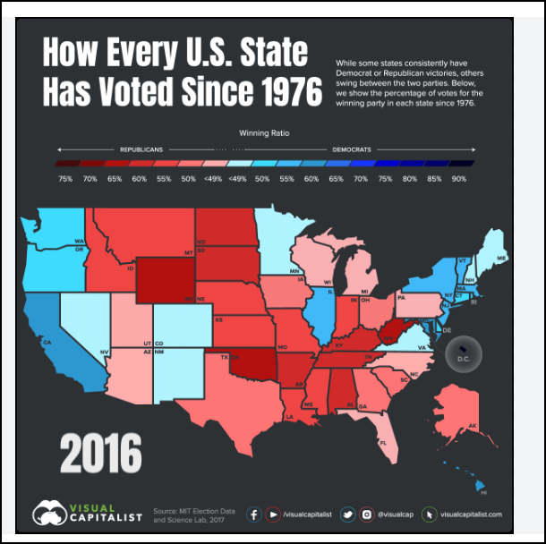
About THIS PROJECT
This project is an academic collaboration to meet the certification requirements of Project 1, Artificial Intelligence Bootcamp.
Presenting Students: Cristina Frisby & Krishan Fotedar

Slide 3
Why Attempt to Predict and Understand Election Results?
Impact
Financial
Personal
Global

Slide 4
Part 1: Explore Election Nationally and by State for major Parties
Voting results by precinct for major elections in the last several decades were evaluated for trending patterns and forecasting methods.

Slide 5
Part 1
INSERT SLIDES HERE
###

Slide 6
Part 1: Predicting general election outcomes based on historical results
Analysis Consisted of two Projects:
1/ Historical Election Results: Run a Prophet time series on presidential election data by state spanning 1976-2020
2/ Bellwether Counties: Run a Prophet time series on the results of 44 ‘bellwether’ counties. Bellwether is defined as a county whose presidential election results match the national vote in all but one election since 1980

Slide 7
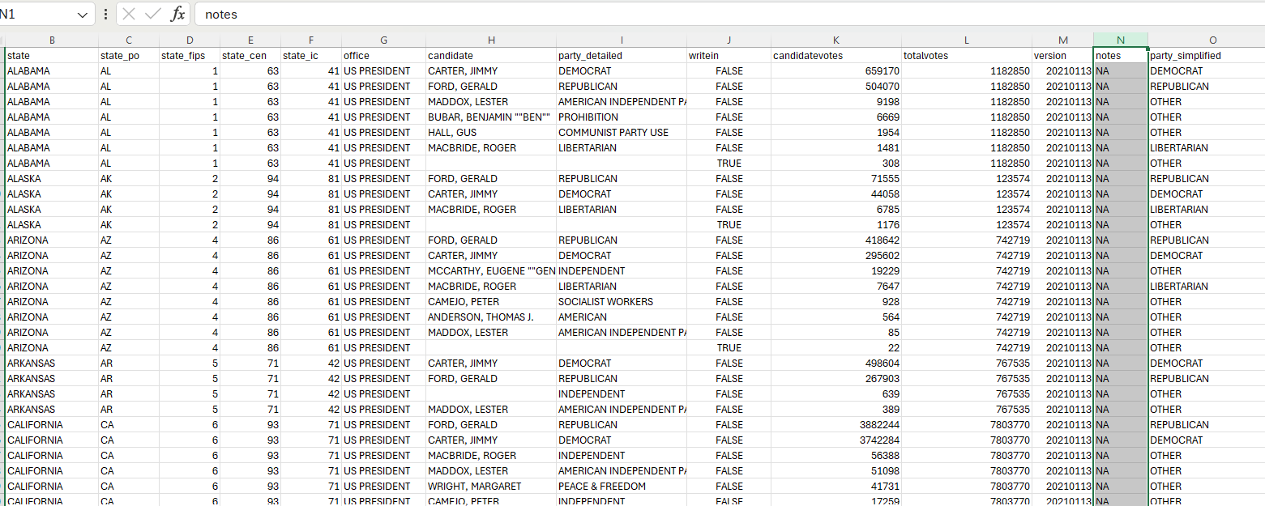
Historical ELECTION RESULTS – DATA PREPARATION Predicting Presidential Election Results by State
Data Source listed presidential results by candidate for each state
from 1976 to 2020
Part of data cleaning was to get the results into 3 buckets:
Democrat
Republican
Other

Slide 8
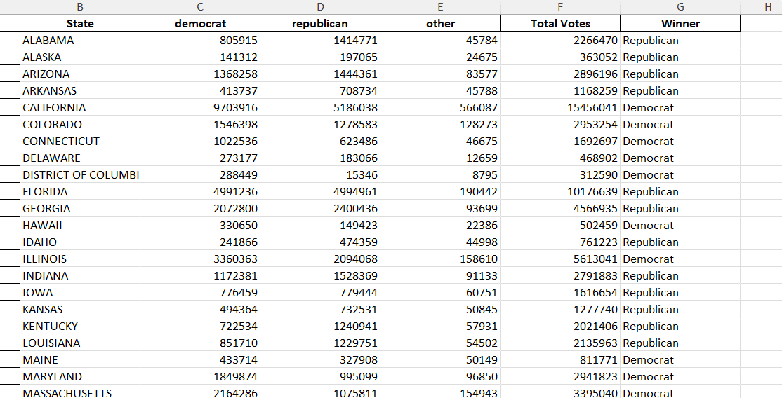
Historical ELECTION RESULTS -2024 Results Predicting Presidential Election Results by State
Ran a Prophet model for each state and each party
Stored results in a dictionary with the state as the key and the value being a 3 element
list with the element being a time-series results for each party
Cycled through the dictionary and identified the 2024 predicted outcome and
labeled the winner
Predicted Popular Vote Result: D – 51%, R – 46%, O-3%
Predicted Electoral Result: D -272, R-262

Slide 9
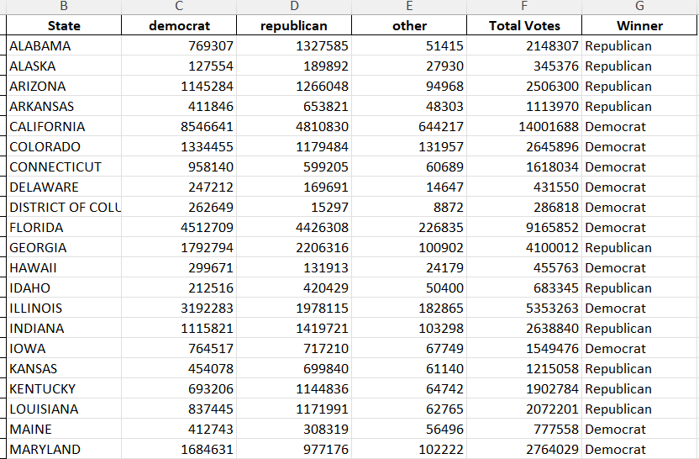
Historical ELECTION RESULTS – 2020 RESULTS Predicting Presidential Election Results by State
Ran a Prophet model to predict the 2020 vote and compared it to the actual 2020 outcome
Model 2020 Popular Vote Result: D – 50%, R – 45%, O-5% , Under-predicted D and R by 1%
Missed on the following states: AZ (R), GA (R), OH (D), IA (D)

Slide 10
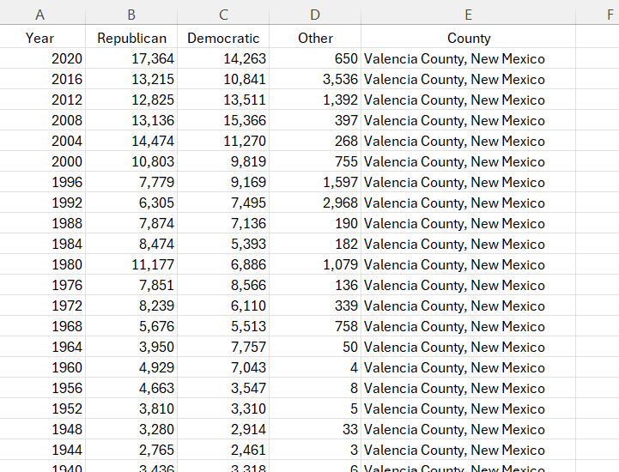
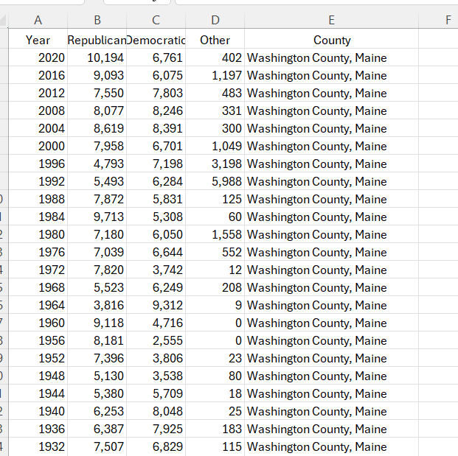
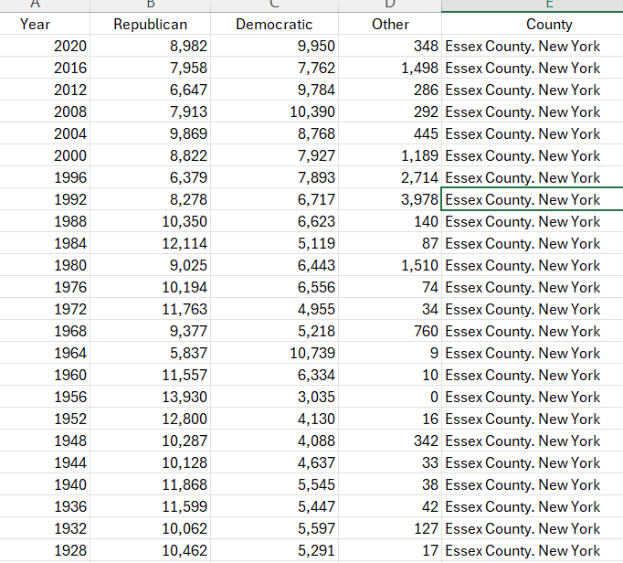
bellwether ELECTION RESULTS – DATA PREPARATION
44 counties have predicted the winner of the presidential election in all but one
election since 1980
Found the data in Wikipedia - filled a 44-tab spreadsheet
Data goes back to the 1880s in some cases, but we only used data since 1980

Slide 11
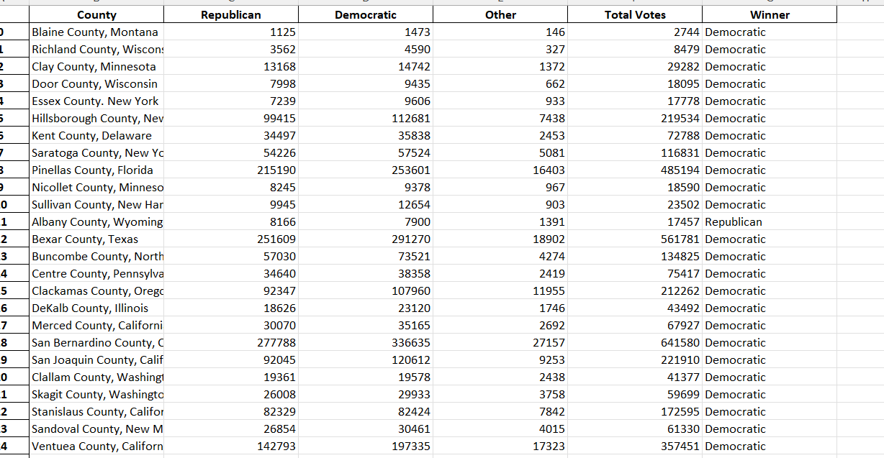
bellwether ELECTION RESULTS – 2024 Results Predicting Presidential Election Results
Ran a Prophet model for each county and each party
Stored results in a dictionary with the county as the key and the value being a 3-element
list with the element being a time-series result for each party
Cycled through the dictionary and identified the 2024 predicted outcome and
labeled the winner
Model is showing 38 counties will vote Democratic, 6 will vote Republican

Slide 12
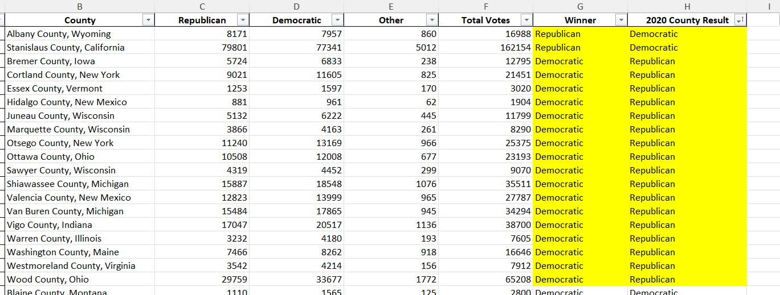
bellwether ELECTION RESULTS – 2020 Results Validate the model
Ran a Prophet model for each county and each party to predict 2020 results
Compared the model 2020 results with 2020 actuals
Missed on 19 of the 44 counties – 2(R), 17(D)
The last 2 election cycles (2016 and 2020) have seen 34 of the 44 misses for these counties
Bellwether counties may no longer be good predictors of national vote outcomes

Slide 13
Part 2: Accessing Voter Demographics through Poll Data
Pew Research Center conducts public opinion polling, demographic research, computational social science research and other data-driven research.
“Party Identification Tables” for 1994 through 2023 were used to investigate demographics including Gender and Race/Ethnicity

Slide 14
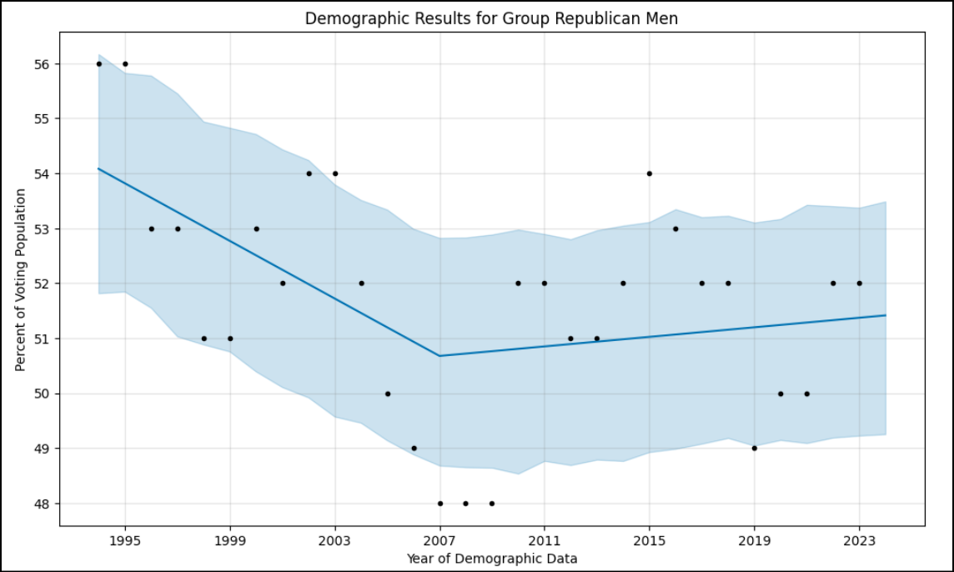
Demographic Analysis Using Prophet Models for 2024 Predictions
Prophet Predictions into 2024 for each demographic group.
Sample: “Republican – Men”

Slide 15
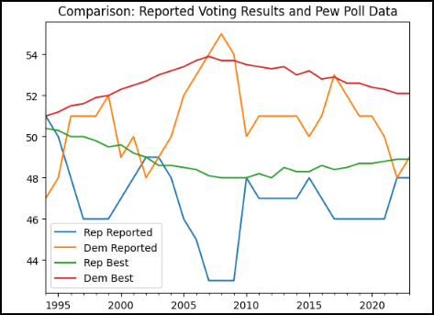
Results Actual Election Results vs Polls (Pew): 1994 through 2023
General Comparison:
Primary Party Candidate Voting Results vs. Predicted Model From Poll Results using “prophet” models
Variances and Similarities:
Disrupter - 2008 Anomaly (Barack Obama)

Slide 16
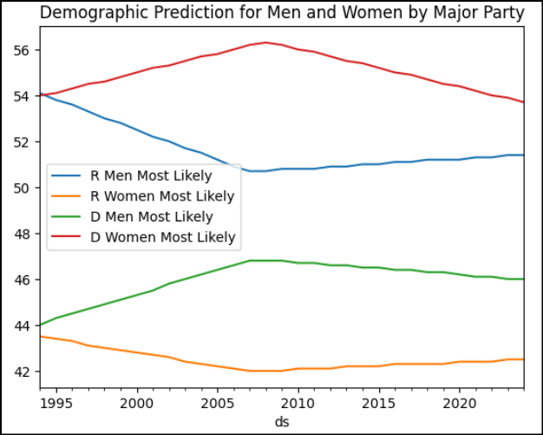
Results Pew Poll Models 1994 through 2024 Demographic: Gender (Men & Women)
General Comparison:
Polling Data Model from 1994 through 2023 and “prophet” prediction for 2024
Variances and Similarities:
Three of 4 groups show little change after 2008 (less than 1%): Stable
One Group indicates a negative trend of more than 2%: Democrat Women
Conclusions:
The Democratic Party should focus on the women’s declining demographic.

Slide 17
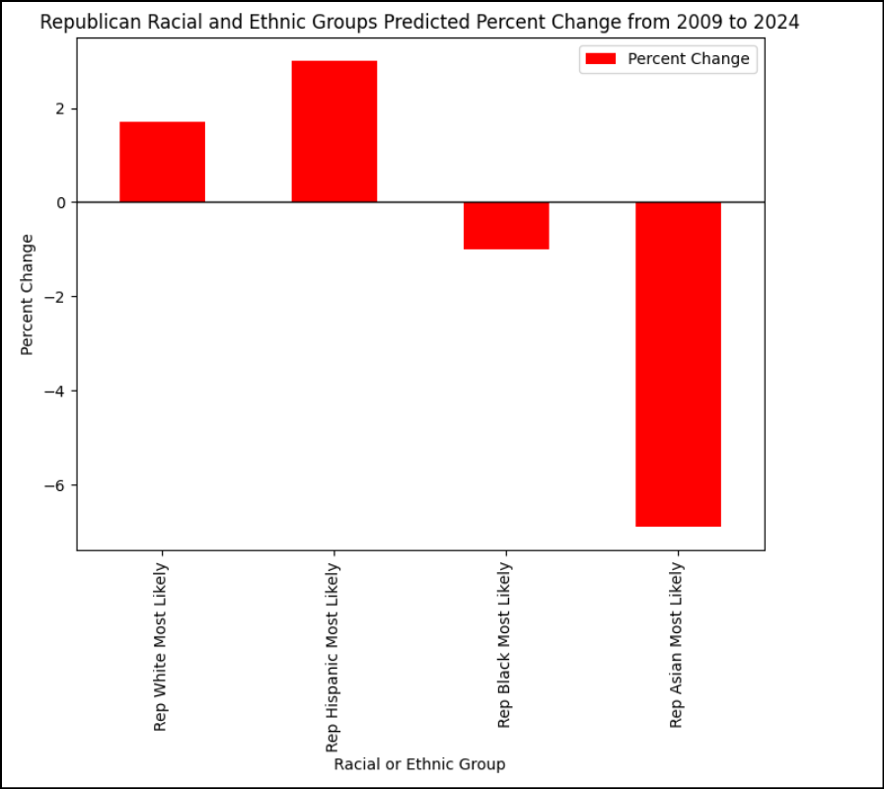
Results Pew Poll Models 1994 through 2024: Demographic: Racial and Ethnic Groups
2024 Impact:
Slightly Upward: White and Hispanic Republican Voters
Slightly Downward: Black Republican Voters
Significantly Downward: Asian Republican Voters
Should The Republica Party focus on Asian Voters to disrupt the trend?
Who are Asian Voters and what are their issues? How diverse is this demographic?

Slide 18
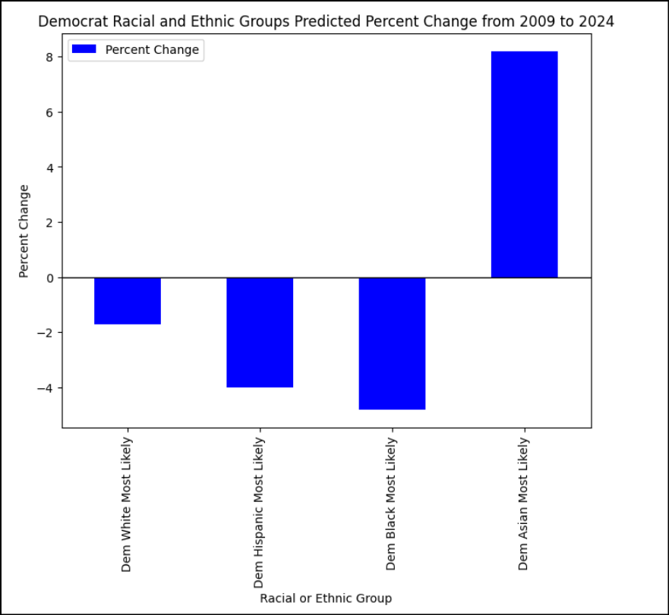
Results Pew Poll Models 1994 through 2024 Demographic: Racial and Ethnic Groups
2024 Impact:
Significantly Upward: Asian Democrat Voters
Slightly Downward: White Democrat Voters
Significantly Downward: Hispanic and Black Democrat Voters
Conclusions:
The Democratic Party can focus on Black and Hispanic voters to disrupt the trend.

Slide 19
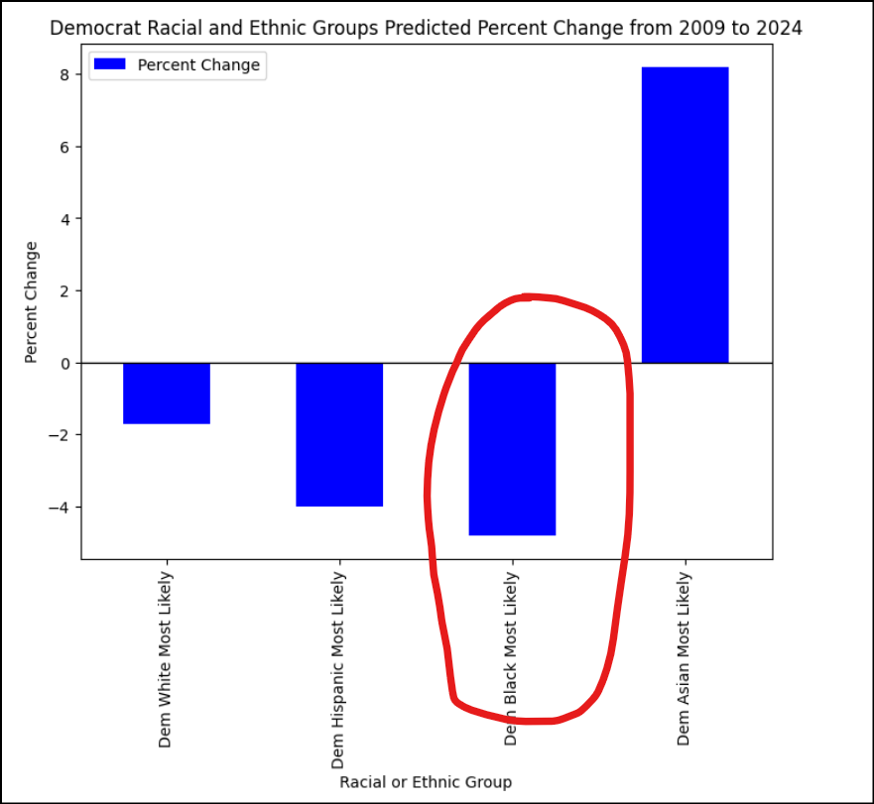
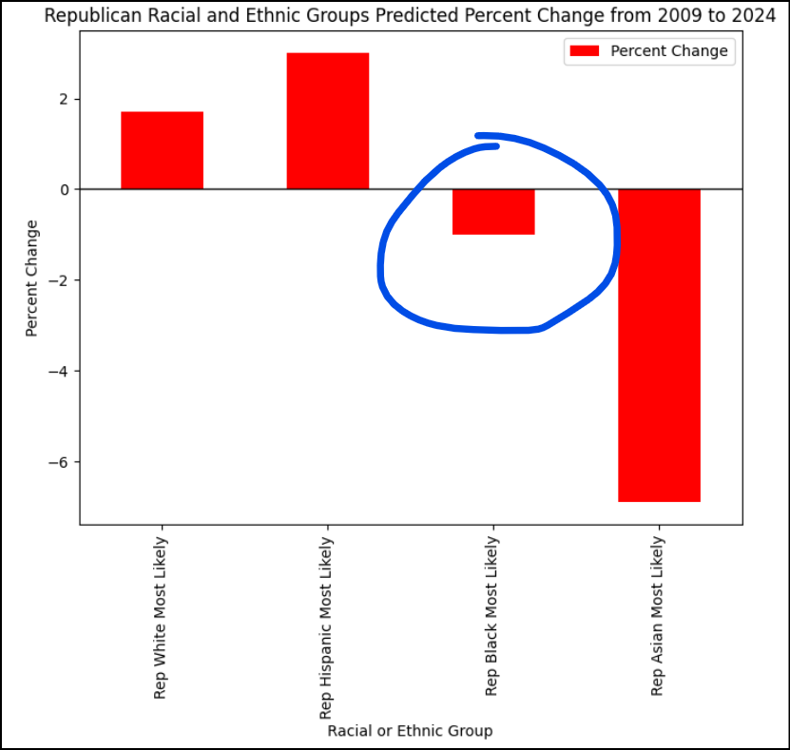
Results Pew Poll Models 1994 through 2024: Demographic: Racial and Ethnic Groups
Voting “Swap”:
White, Hispanic and Asian demographics are “swapping” similar percentage points on Republican and Democrat Parties.
Where are the Black voters going? Black voters trending negative both Democrat and Republican.
Are Democrats more impacted by the trend than Republicans?
Conclusion: Black voters may be voting independent or not voting.

Slide 20




Solution
Close the gap
Target audience
Cost savings
Easy to use
Our product makes consumer lives easier, and no other product on the market offers the same features​
Gen Z (18-25 years old)
Reduce expenses for replacement products
Simple design that gives customers the targeted information they need​

Slide 21



Product Overview
Unique
First to market
Only product specifically dedicated to this niche market
First beautifully designed product that's both stylish and functional​
Tested
Authentic
Conducted testing with college students in the area​
Designed with the help and input of experts in the field ​

Slide 22
Product Benefits
Cool and stylish product​
Areas for community connections
Online store and market swap​

Slide 23


And The Winner is:

Slide 24



Business Model
Research​
Abstract​
Design​
We based our research on market trends and social media​
We believe people need more products specifically dedicated to this niche market​
Minimalist and easy to use ​

Slide 25
Market opportunity overview
$3b
$1b
$2b
Opportunity to build​
Fully inclusive market​
Total addressable market​
Freedom to invent​
Selectively inclusive market​
Serviceable available market​
Few competitors​
Specifically targeted market​
Serviceable obtainable market​

Slide 26
Market opportunity comparison
$3B
Opportunity to Build
Revenue over 12 months​
$2B
Freedom to Invent
Market share​
$1B
Few Competitors
Obtainable market​

Slide 27
Our competition
CoNTOSO
competitors
Our product is priced below that of other companies on the market​
Design is simple and easy to use, compared to the complex designs of the competitors​
Affordability is the main draw for our consumers to our product​
Company A​ Product is more expensive​
Companies B & C ​ Product is expensive and inconvenient to use​
Companies D & E​ Product is affordable, but inconvenient to use

Slide 28
Our competition graphic
convenient
Contoso
A
expensive
affordable
D
B
C
E
Inconvenient​

Slide 29
Growth strategy
How we’ll scale in the future
Feb 20xx
May 20xx
Oct 20xx
Roll out product to high profile or top-level participants to help establish the product​
Release the product to the general public and monitor press release and social media accounts​
Gather feedback and adjust product design as necessary​

Slide 30
Traction
Forecasting for success​
Key metrics
Revenue by year
 | clients | orders | Gross avenue | Net revenue
20XX​ | 10​ | 1100​ | $10,000​ | $7,000​
20XX​ | 20​ | 200​ | $20,000​ | $16,000​
20XX​ | 30​ | 300​ | $30,000​ | $25,000​
20XX​ | 40​ | 400​ | $40,000​ | $30,000​
20XX​ | 50​ | 500​ | $50,000​ | $40,000​
20XX | 10 | 1100 | $10,000 | $7,000

Slide 31
Two-year action plan
Draft blueprints​
Run focus groups​
Gather feedback​
20XX
Jan
Feb
Mar
Apr
May
Jun
Jul
Aug
Sep
Oct
Nov
Dec
Test design​
Launch design​
Deliver to client
20XX
Jan
Feb
Mar
Apr
May
Jun
Jul
Aug
Sep
Oct
Nov
Dec

Slide 32
financials
 | Year 1 | Year 2 | year 3
Detailers​ | 5,000​ | 40,000​ | 160,000​ | ​
Users​ | 50,000​ | 400,000​ | 1,600,000​ | ​
Sales​ | 500,000​ | 4,000,000​ | 16,000,000​ | ​
Average price per sale​ | 75​ | 80​ | 90​ | ​
Revenue @ 15%​ | 5,625,000​ | 48,000,000​ | 216,000,000​ | ​
Gross Profit​ | 5,625,000​ | 48,000,000​ | 216,000,000​ | ​
Expenses​ | ​ | ​ | ​ | ​
Sales & marketing​ | 5,062,500​ | 38,400,000​ | 151,200,000​ | ​
Customer service​ | 1,687,500​ | 9,600,000​ | 21,600,000​ | 70%​
Product development​ | 562,500​ | 2,400,000​ | 10,800,000​ | 10%​
Research​ | 281,250​ | 2,400,000​ | 4,320,000​ | 5%​
Total Expenses​ | 7,593,750​ | 52,800,000​ | 187,920,000​ | 2%​
EBIT | -1,968,750 | -4,800,000 | 28,080,000 | ​

Slide 33




Our team
Takuma Hayashi​​
Mirjam Nilsson​​
Flora Berggren​​
Rajesh Santoshi​​
President
Chief Executive Officer​
Chief Operations Officer​
VP Marketing​

Slide 34








Our team
Takuma Hayashi​​
Mirjam Nilsson​​
Flora Berggren​​
Rajesh Santoshi​​
President
Chief Executive Officer​
Chief Operations Officer​
VP Marketing​
Graham Barnes​
Rowan Murphy​
Elizabeth Moore​
Robin Kline​
VP Product​
SEO Strategist​
Product Designer​
Content Developer​

Slide 35
Funding
12K
14K
32K
82K
Property
Angel Investments
Cash
Shares
Revenue obtained from property rentals​
Amount obtained through other investors​
Liquid cash we have on hand​
Number of shares converted into USD​

Slide 36
Summary
Elections can be greatly influenced by historic events, but patterns do emerge in the trends.
Which way are the election results trending?
Historically, which areas most likely predict the national winner?

Slide 37
Thank you
Mirjam Nilsson​​
206-555-0146​
mirjam@contoso.com​
www.contoso.com​

